Slide 1
Step 1: Meta Atom
Create a "digital library" that links nanostructure geometry to its optical performance.
Lock down manufacturing rules with the fab (e.g., materials, minimum feature size, spacing).
Simulate meta-atom with Ansys Lumerical or similar program
Build LookUp Table (LUT).
  Database that maps geometry parameters

Slide 2
Step 2: Library development and P-cell
Automate the creation of complex metalens layouts from simple, high-level inputs (λ, NA, FOV, polarization)
Develop scripts that generate layouts automatically.
Create high-level parameters like focal length, numerical aperture, and wavelength.
The P-cell script uses the LUT to calculate and place millions of individual meta-atoms, generating a final GDSII layout file.
Build P-cells for all needed components: focusing lenses, collimators, beam steerers, etc.

Slide 3
Step 3: Verification & Manufacturability
Ensure every design is physically manufacturable and optically correct before fabrication.
Design Rule Checking (DRC):
  Automatically flags violations like features that are too small or too close together
Functional Verification (LVS):
  Compares the generated phase profile of the layout against the ideal theoretical profile

Slide 4
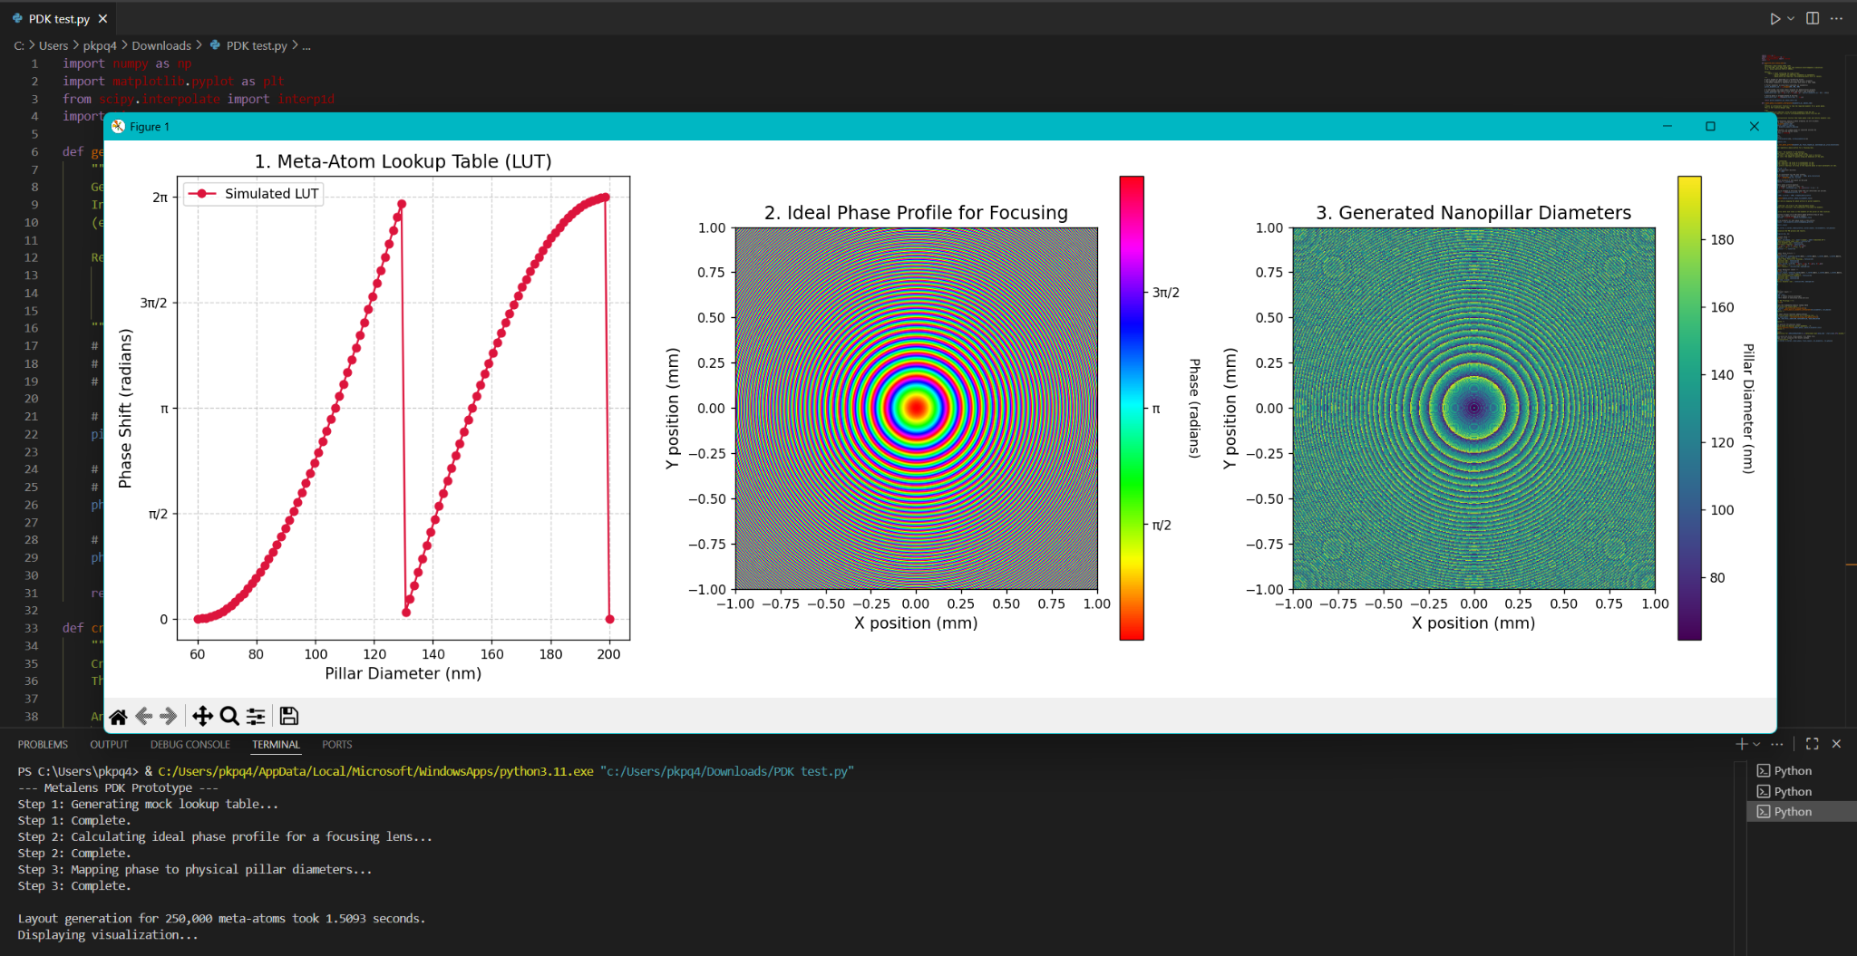
Test program

